Slide 2
KubeEdge DeepDive: Architecture, Use Cases, and Project Graduation Updates
Shubham Singh, Independent

Slide 3

About Myself
Hi 👋
This is Shubham
Computer Science Student
LFX 2024 graduated mentee
CNCF Contributor
Org member at KubeEdge
First time KubeCon speaker
GitHub: @1shubham7
Twitter: @1shubham7

Slide 4

KubeEdge Graduated
https://www.cncf.io/announcements/2024/10/15/cloud-native-computing-foundation-announces-kubeedge-graduation/

Slide 5
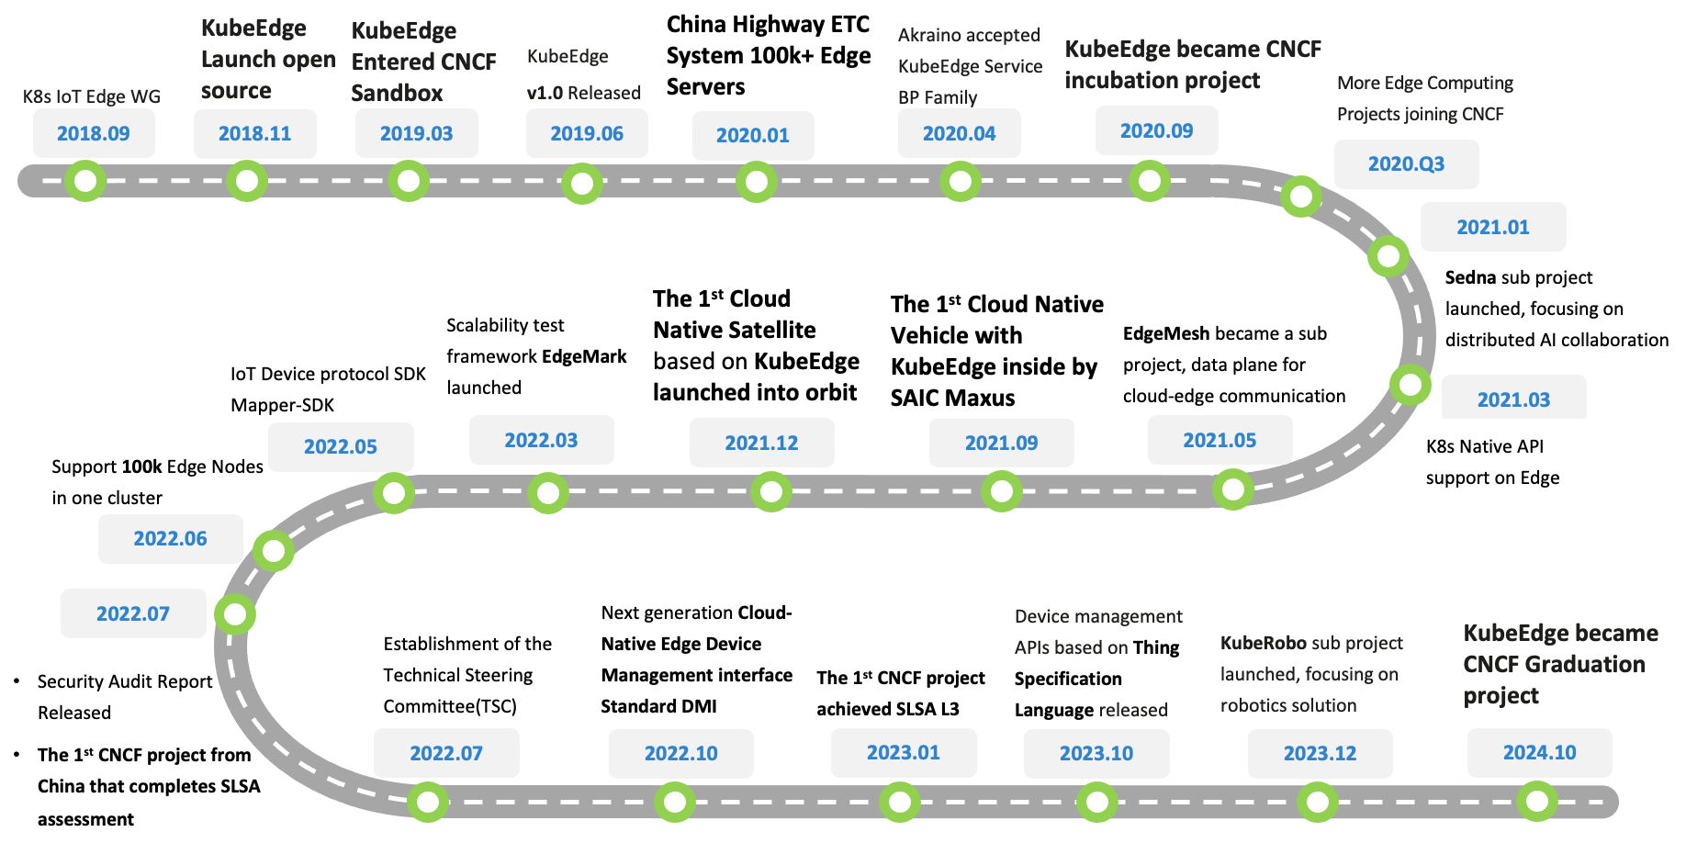
Innovative project journey

Slide 6
Project Background

Slide 7






Background
Home
ACC
AGG
Metro
Enterprise
~50km
1~5ms
50~200km
5~10ms
eNodeB
>200km
>20ms
Nearside Edge
City Edge
Regional Edge
Cloud
EDGE
MEC
MEC
MEC
Cloud
Services
Cloud Services
Millions
Hundreds-Thousands
Tens- Hundreds
tens
Typical Apps
V2X, AR/VR, AI
AI Inference
vCDN, AR/VR
Rendering, Video transcoding
AI Training , Big Data
AI Training/Inferencing, Video transcoding

Slide 8

















The KubeEdge Project
Flexible quality inspection
OCR
Facial Recognition
Behavior Analysis
…
KubeEdge - EdgeCore
KubeEdge - CloudCore
Device
Management
Edged
Meta Manager
Cloud - Edge
Coordination
CloudHub
DeviceController
EdgeController
EventBus
DeviceTwin
EdgeHub
Data Access
The first Cloud Native Edge Cloud Computing OSS Project
Open Governance, connecting Cloud Native and Edge Computing Ecosystem
7,600+ stars, 2,100+ forks on GitHub
1500+ contributors (350+ code committers) from 100+ organizations
Edge Computing scenarios oriented, designed for edge-cloud collaboration.
Consistent experience of Applications, Resources, Data, Devices, etc. between cloud & edge

Slide 9
Project introduction and updates

Slide 10
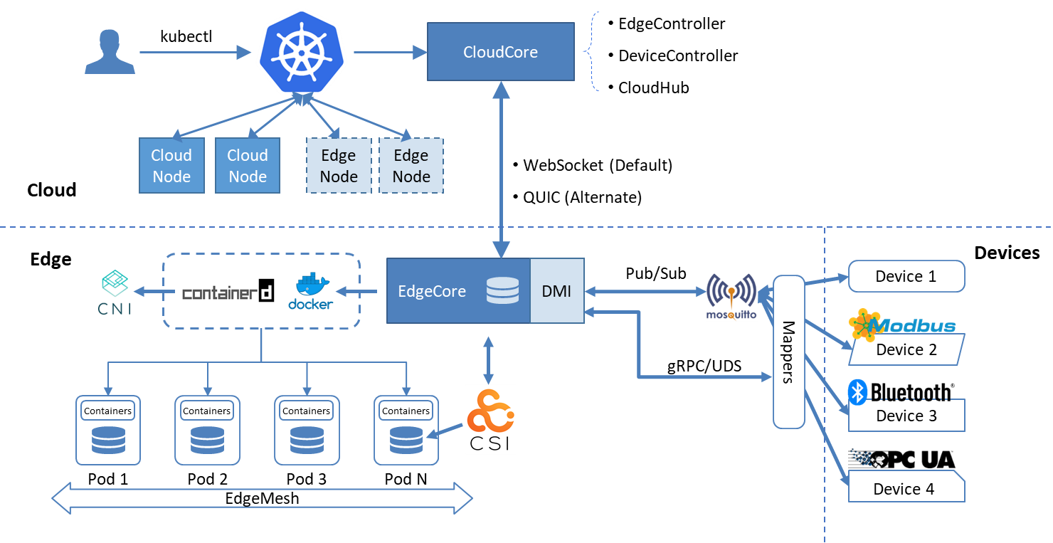
KubeEdge Architecture
Seamless Cloud-Edge Coordination
Edge Autonomy
Low Resource Readiness
Simplified Device Communication
Open Ecosystem

Slide 11
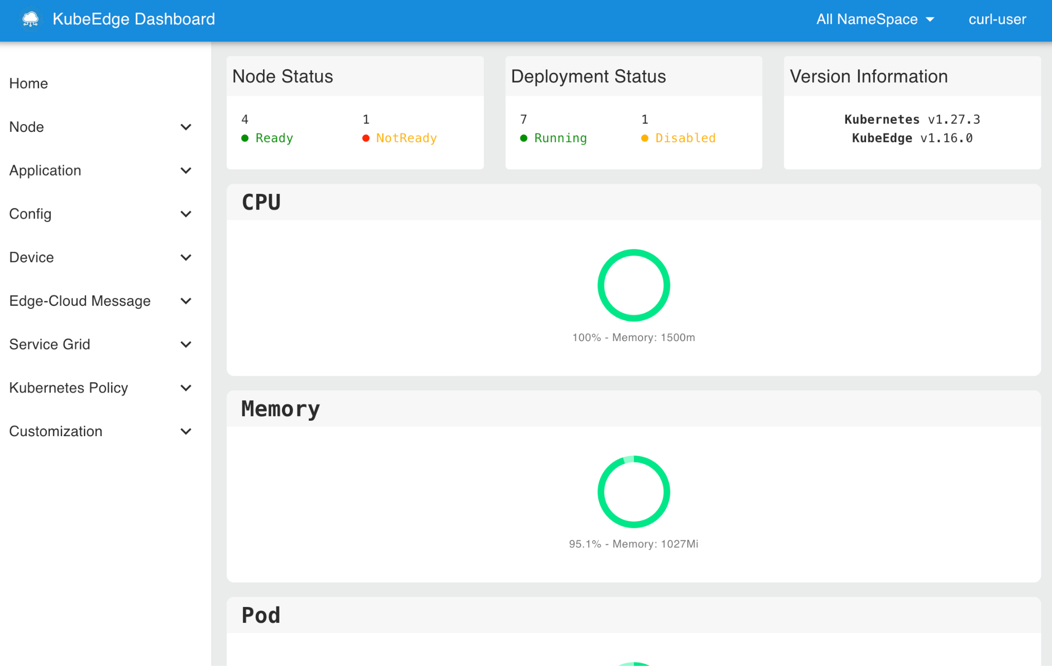
What’s New
KubeEdge v1.19 is live! (Oct 2024)
Support Edge Nodes Report Event
kubectl get events or kubectl describe {resource_type} {resource_name}.
Support OTA(Over-The-Air) Upgrades for Edge Nodes
Mapper Supports Device Data Writing
NEW Device method API AND improved Device data writing
Add OpenTelemetry to Mapper-framework
A New Release of KubeEdge Dashboard

Slide 12

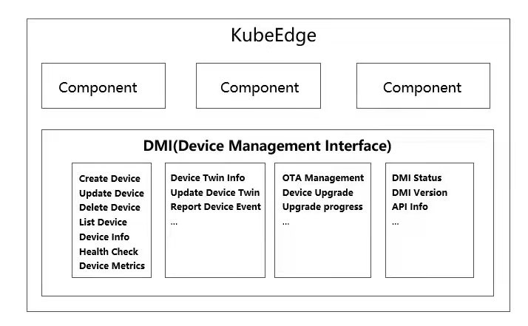
SIG Device-IoT: Device Management Interface (DMI)
DeviceModel API (CRD)
Device API (CRD)
KubeEdge Cloud Cluster
Decoupled control plane and data plane for IoT devices
Device (data) as a Service
Help developers to focus on their own application development
Reduced channel congestion between cloud and edge
A more flexible and unified way to manage IoT Devices
Device Controller
Cloud Hub
Data APP
in Cloud
Cloud
Kubernetes
Edge
EdgeCore
EdgeHub
Device Manager（Device Twin）
Data
over
EdgeMesh
MQTT Broker
plugins
DMI API (Rest)
Data APP
on Edge
Data
over EdgeMesh
Mapper Container
Device Modelling
Data Collection
Data Forwarding
OPC-UA plugin
Bluetooth plugin
Modbus plugin
https://www.cncf.io/blog/2022/10/05/kubeedge-design-and-implementation-of-the-next-generation-cloud-native-edge-device-management-standard-dmi/
Features updates:
New Device APIs, including build-in protocols like Modbus, Opc-UA and Bluetooth
Mapper supports video streaming data reporting
Support mapper upgrade

Slide 13
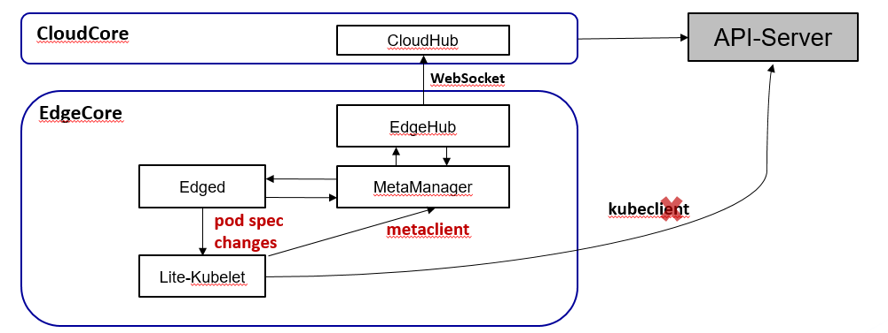
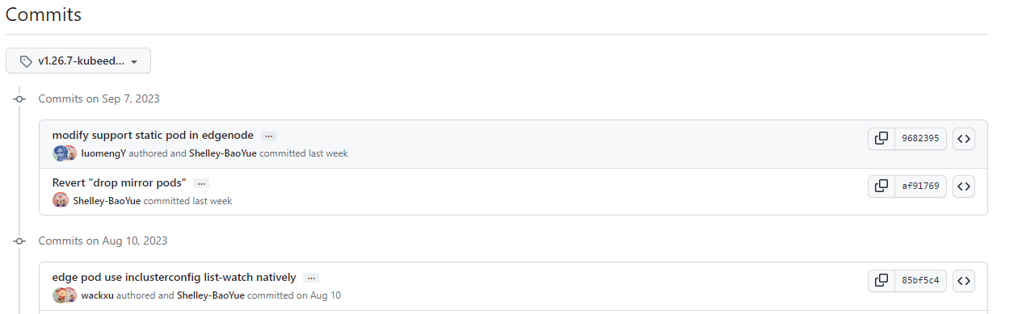
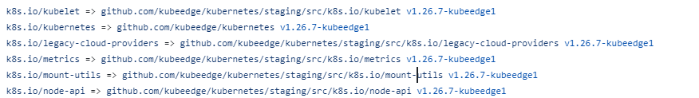
SIG Node: Edge Architecture
Cloud
CloudHub
Global Store
WebSocket
EdgeHub
MetaManager
kubeedge/kubernetes
Edge Store
DeviceTwin
Meta Server
K8s Operator
Edged（Kubelet-Lite）
Docker
Containerd
CRI-O
kubeedge/kubeedge go.mod
Runtime
Runc
Kata
Runv
Features updates:
Support image pre-pull on the edge
Support Auto-Restarting for edge modules
Support more deployment fields override for edge applications

Slide 14
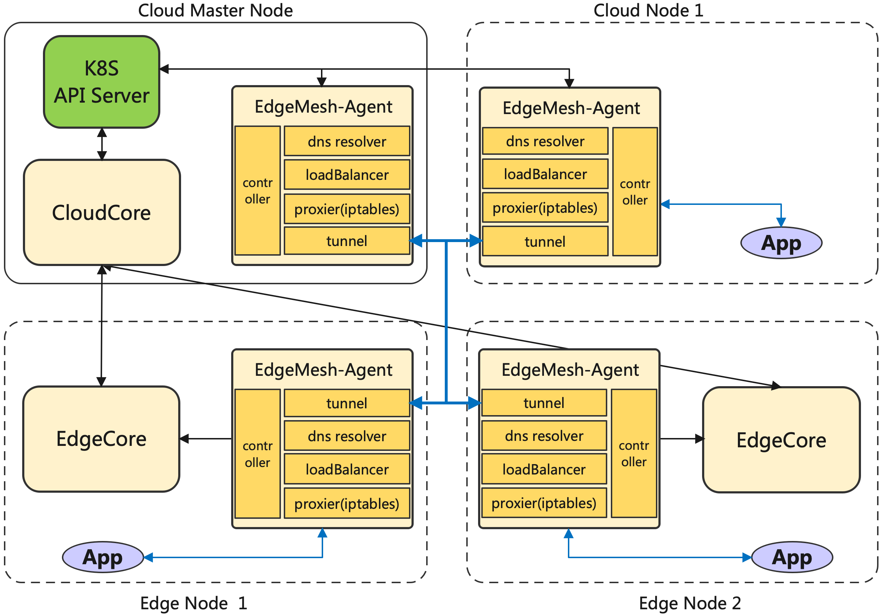
SIG Networking: Edgemesh, adaptive multi-edge/cloud-edge network
"Serverless" design, adaptive multi-edge and cloud-edge network Tunneling
Built-in edge local DNS resolution, independent of central DNS
Consistent service discovery and access experience across the edge and cloud.
Supports Layer 4 and Layer 7 traffic management.
Multi-edge and cross-subnet communication
WIP: Supports standard istio for service governance.

Slide 15

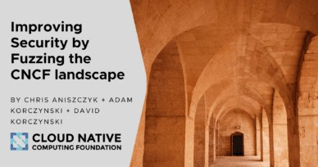
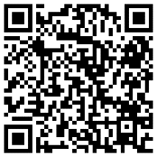
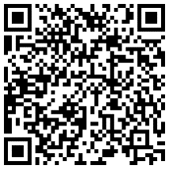
SIG Security
One of the first CNCF Project integrating with Fuzzing
https://www.cncf.io/blog/2022/06/28/improving-
security-by-fuzzing-the-cncf-landscape/
One of the First CNCF project reaching L3 of Supply Chain Levels for Software Artifacts (SLSA)
Source, Build and Common All reached L4
KubeEdge Full Audit Report
https://github.com/kubeedge/community/tree/master/sig-security/sig-security-audit/KubeEdge-security-audit-2022.pdf
KubeEdge Threat Model And Security Protection Analysis
https://github.com/kubeedge/community/blob/master/sig-security/sig-security-audit/KubeEdge-threat-model-and-security-protection-analysis.md
KubeEdge Security Policy and Vulnerability Management
https://github.com/kubeedge/community/blob/master/security-team/SECURITY.md

Slide 16
Edge AI

Slide 17
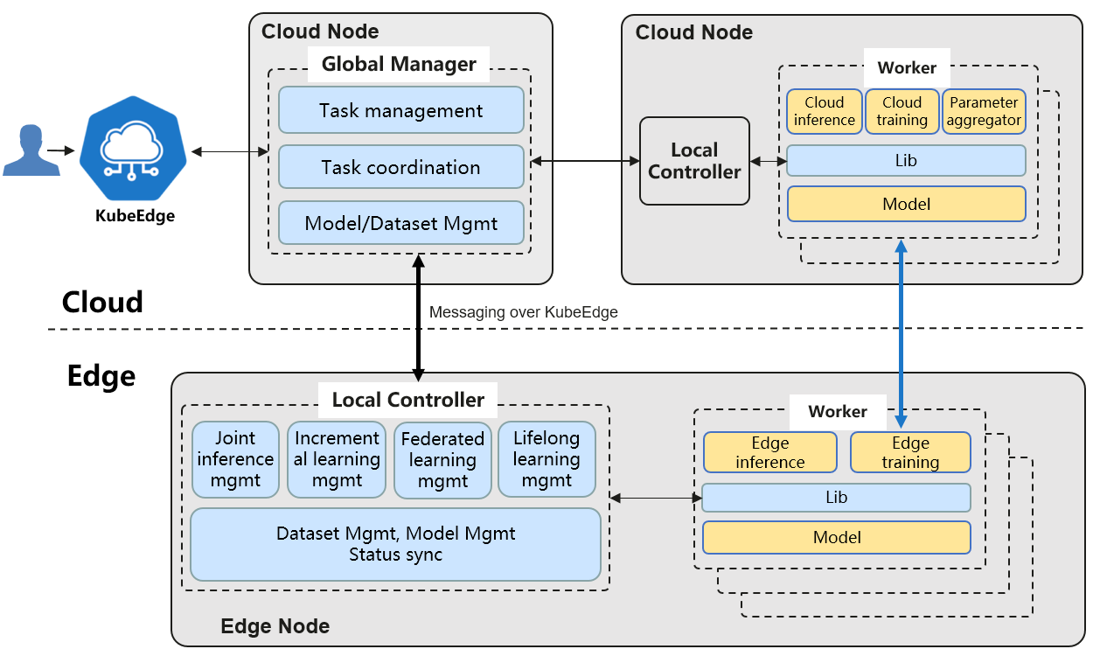
SIG AI: Sedna, Distributed AI collaboration Kit
AI framework fueled by edge-cloud synergy
Dataset and model management across the edge and cloud
Training and inference frameworks fueled by edge-cloud synergy
Joint inference
Incremental learning
Federated learning
Lifelong learning
Open ecosystem
Compatible with mainstream AI frameworks: TensorFlow, PyTorch, Paddle, MindSpore, etc.
Provides extended interfaces for developers to quickly integrate third-party algorithms

Slide 18
Cloud-Edge Collaboration Lifelong Learning
Knowledge Lib
For small sample size and heterogeneous edge data:
Knowledge lib in cloud provides memory. The sample knowledge accumulated on the edge is continuously updated and persistently stored, thereby mitigating the problem of catastrophic forgetting.
By combining incremental training and multi-task training, as well as cross-temporal and cross-scenario knowledge transfer, it’s able to better handle unknown tasks.
1
Cloud
2
3
4
Unseen Task Processing
Edge
Unseen Task
Detection
Unseen Task
Detection
Unseen Task
Detection
Unseen Task
Detection
Unseen Task
Detection
Inference
Inference
Inference
Inference
Inference
Task Model
App @Edge A
App @Edge B
App @Edge A
App @Edge C
App @Edge D
Task Sample
…
…
T-N
…
T-2
T-1
T
T+1
T+2
…
T+M
Time
Edge Node A
Edge Node B
Edge Node A
Edge Node C
Edge Node D
N history task
Current task
M future task

Slide 19
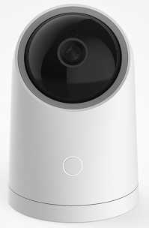
Cloud-Edge Collaboration Federated Learning
Isolated data does not leave the edge
Knowledge aggregation produces the model
Developers: import the edge AI Lib, develop edge-cloud collaboration federated learning program
Launch the federated learning task, deploy the training program to edge
Edge 1
app
model
Cloud
Aggeration Algo
Multi-task detection, divide the Non-IID sample set, and cooperate with the cloud to recognize similar tasks
Local training, upload model parameters to the cloud, and cloud runs cross-edge migration + model aggregation algorithms
Labeling
Service
local samples
local incre-training
Algo
models parameters updating
Edge 2
Labeling
Service
local samples
local incre-training
Algo
Sedna Federated-Learning Service API
app
model

Slide 20
Cloud-Edge Joint-Inference
Under resource-constrained lateral conditions, improving overall reasoning performance.
Perform inference with shallow model on the edge, and if the confidence level is met, directly return the result
Otherwise sent the data to cloud and inference with cloud large model
Edge 1
App
Shallow Model
Hard example mining
Cloud
Edge 2
App
Sedna
Joint-Inference
API
Developer
Shallow Model
Hard example mining
Deep Model
大模型
推理
大模型
推理
AI developers：provide data to train deep models and shallow models
Business developers：call the joint-inference models through Sedna lib and deploy them to edge
Edge 3
App
Shallow Model
Hard example mining

Slide 21
Case Studies

Slide 22
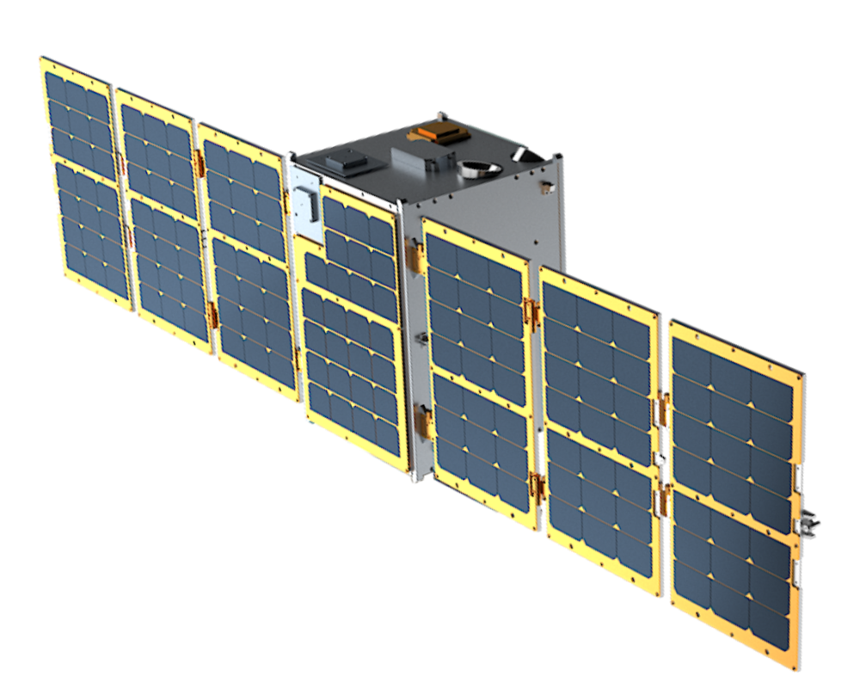
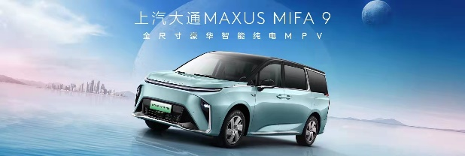



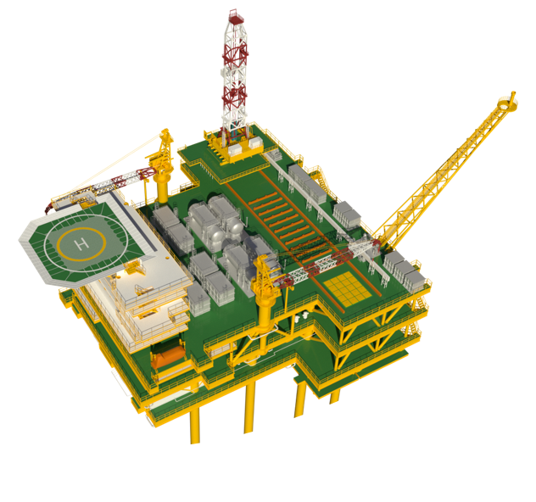

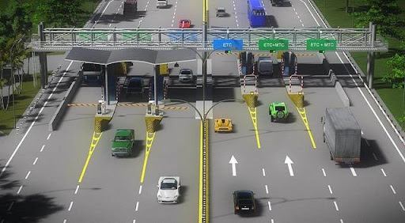
New Boundaries: More traditional Industries to Cloud Native
Intelligent Transporation:
China Highway ETC system
Hong Kong-Zhuhai-Macao Bridge
Ci4Rail GmbH: Rail and Public Transportation
Smart Energy:
CNOOC Limited: Cloud Native Offshore Oilfield
Jingying Shuzhi: Coal Mine Brain
Industrial Intelligent:
Sanlian Hope: Flexible Visual Quality Inspection
Raisecom: Smart Factory
National Industrial Internet Big Data Center
Smart CDN:
China Telecom eCloud: Smart CDN
Cloud Native Vehicle:
SAIC Maxus: Cloud Native SOTA
LEO Satellite:
Sky Computing Constellation: Cloud Native Satellite
Smart Campus:
XingHai-IoT: Smart Campus/Community
Finance:
CCB China: Smart Bank
Smart logistics
SF Express
ZTO Express
Chemical Plant:
East Hope: Digital factory
Power Industry:
China Southern Power Grid
Accelerators:
Vastaitech: Edge AI Accelerator
Others:
CMCC: Smart Video Cloud
CMCC: 10086.cn, customer service platform
Cloud Native Satellite
Cloud Native Vehicle
Cloud Native Offshore Oilfield
Smart CDN
Electronic toll collection

Slide 23
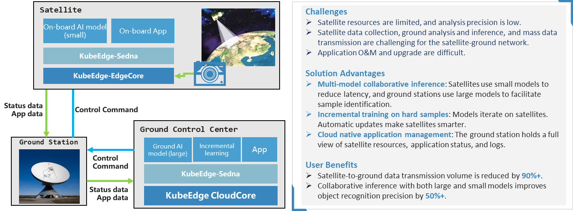
Cloud Native into outer space: Low Earth Orbit Satellite

Slide 24
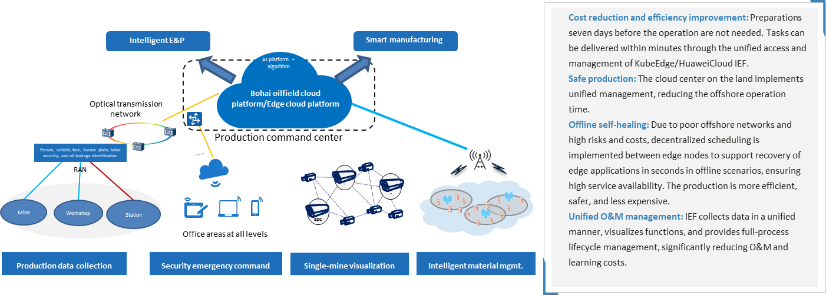
Cloud Native into the Sea: Smart Offshore Oilfield

Slide 25
Achievements Built on a Thriving Community

Slide 26
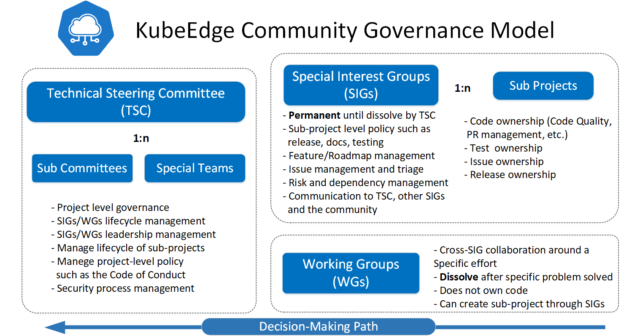
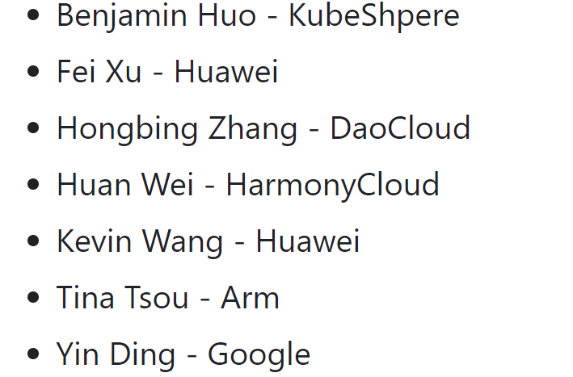
Open Governance
TSC Members
11 SIGs
SIG Node
SIG Device-IOT
SIG Networking
SIG Scalability
SIG Security
SIG Robotics
SIG AI
SIG MEC
SIG Release
SIG Testing
1 WG
WG wireless

Slide 27


















































Diverse Partnerships Across Industry, Academia and Research

Slide 28
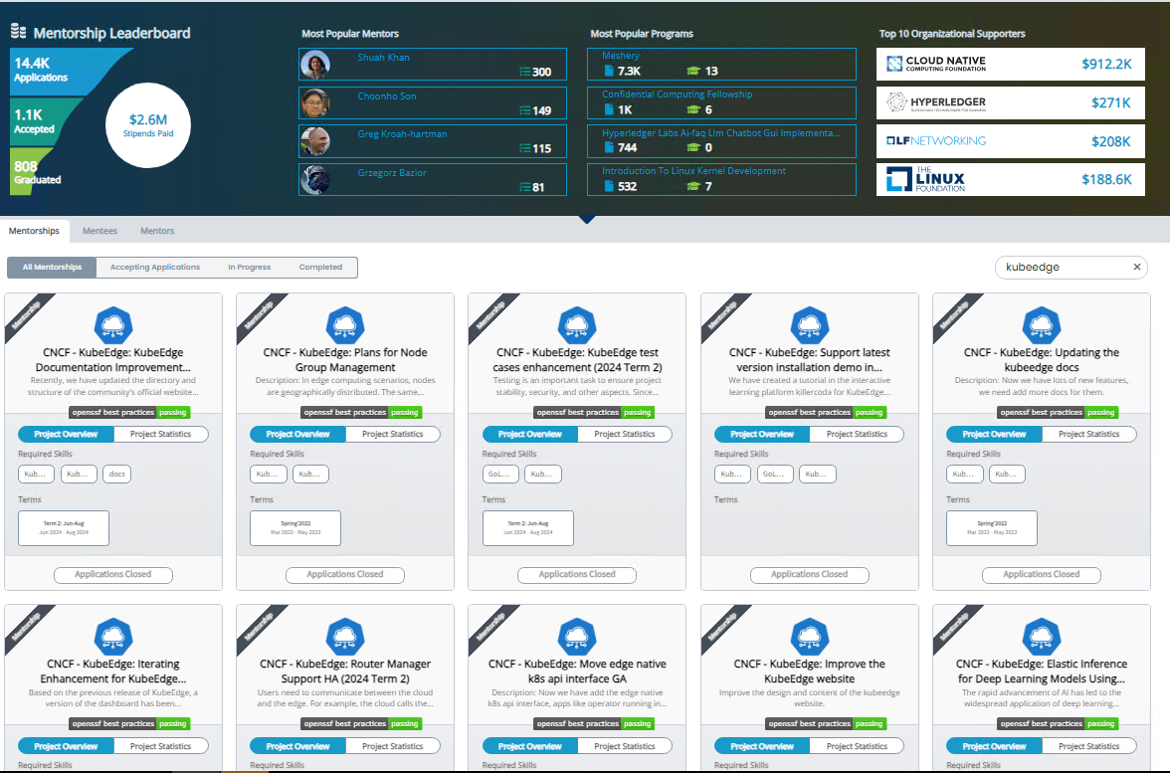
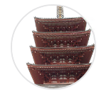
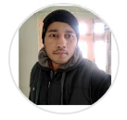
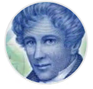

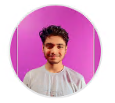
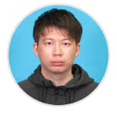

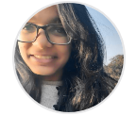

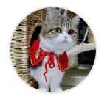



More Activities
Participated in the LFX Mentorship program for 4+ years, providing 20+ projects, Covering multiple areas including feature development, documentation, testing, frontend, and more.
Looking forward to joining forces with emerging talents in the field of computer science to explore the digital future.
https://kubeedge.io/partners

Slide 29
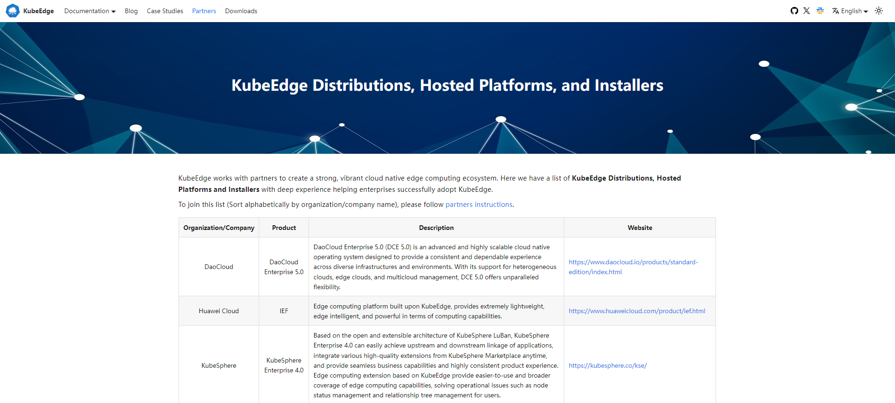
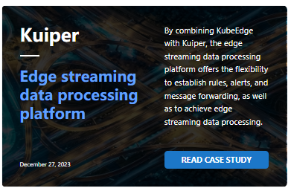
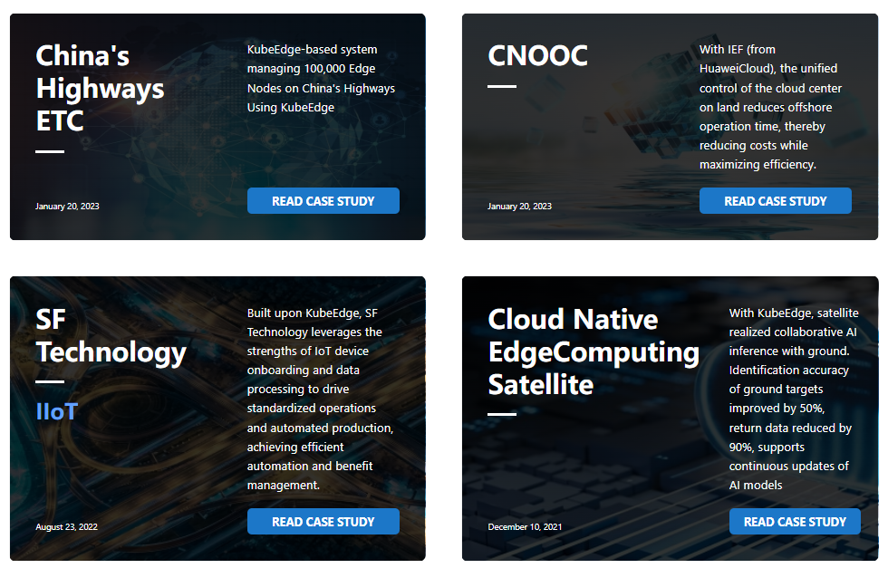
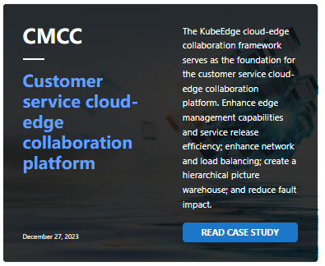
More Activities
Partners
Works with partners to create a strong, vibrant cloud native edge computing ecosystem.
List of KubeEdge Distributions, Hosted Platforms and Installers
Join it if you have the related product
https://kubeedge.io/partners
Case Studies
https://kubeedge.io/partners
Designed to show successful cases of users who have implemented KubeEdge in their business scenarios
Learn how to use KubeEdge in real scenarios
Share your successful cases with other users
https://kubeedge.io/case-studies

Slide 30



Join Us Making Cloud Native Ubiquitous!
Multi Domain, Multi-Scene, Edge Computing Platform
Make Cloud Native Ubiquitous
https://github.com/kubeedge
https://kubeedge.slack.com

Slide 31
Thank you

